Slide 1
Study Skills 101
Overcoming Test Anxiety

Slide 2
What is Test Anxiety?
Test anxiety is actually a type of performance anxiety — a feeling someone might have in a situation where performance really counts or when the pressure's on to do well. For example, a person might have performance anxiety just before trying out for the school play, singing a solo on stage, getting into position at the pitcher's mound, stepping onto the platform in a diving meet, or going into an important interview.
Like other situations in which a person might feel performance anxiety, test anxiety can bring on "butterflies," a stomachache, or a tension headache. Some people might feel shaky or sweaty, or feel their heart beating quickly as they wait for the test to be given out. A student with really strong test anxiety may even feel like he or she might pass out or throw up.
Test anxiety is not the same as doing poorly on a certain test because your mind is on something else. Most people know that having other things on their minds — such as a breakup or the death of someone close — can interfere with their concentration and prevent them from doing their best on a test.

Slide 3
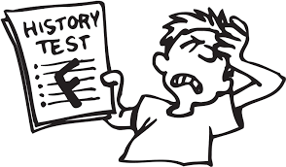
What Causes Anxiety?
Fear of Failure. While the pressure to perform can act as a motivator, it can also be devastating to individuals who tie their self-worth to the outcome of a test.
Lack of Preparation. Waiting until the last minute or not studying at all can leave individuals feeling anxious and overwhelmed.
Poor Test History. Previous problems or bad experiences with test-taking can lead to a negative mindset and influence performance on future tests.

Slide 4
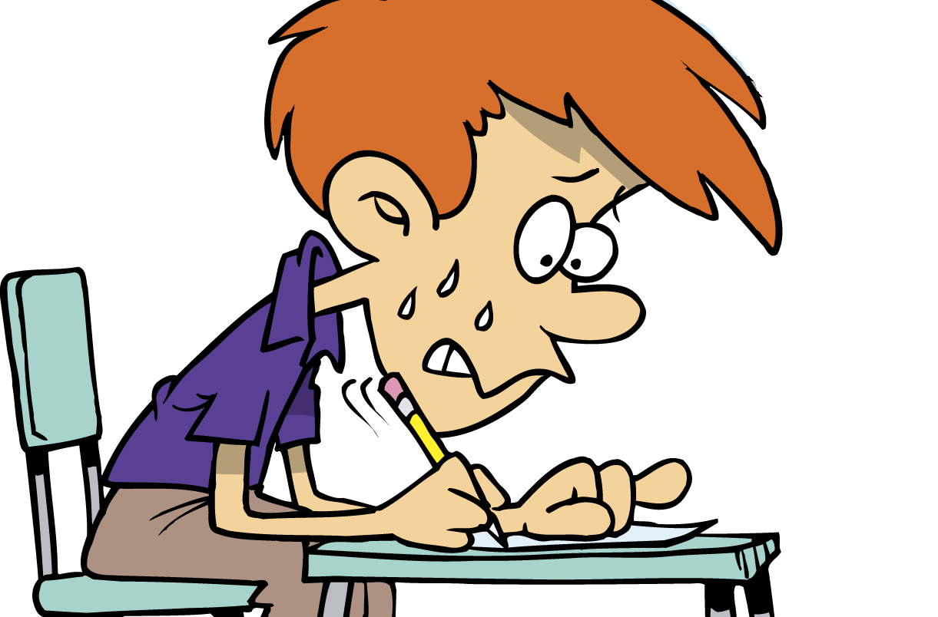
Symptoms of Test Anxiety
Physical Symptoms. Headache, nausea, diarrhea, excessive sweating, shortness of breath, rapid heartbeat, light-headedness and feeling faint can all occur. Test anxiety can lead to a panic attack, which is the abrupt onset of intense fear or discomfort in which individuals may feel like they are unable to breathe or having a heart attack.
Emotional Symptoms. Feelings of anger, fear, helplessness and disappointment are common emotional responses to test anxiety.
Behavioral/Cognitive Symptoms. Difficulty concentrating, thinking negatively and comparing yourself to others are common symptoms of test anxiety.

Slide 5
Who is Likely to Have Test Anxiety?
People who worry a lot or who are perfectionists are more likely to have trouble with test anxiety. People with these traits sometimes find it hard to accept mistakes they might make or to get anything less than a perfect score. In this way, even without meaning to, they might really pressure themselves. Test anxiety is bound to thrive in a situation like this.
Students who aren't prepared for tests but who care about doing well are also likely to have test anxiety. If you know you're not prepared, it's a no-brainer to realize that you'll be worried about doing poorly. People can feel unprepared for tests for several reasons: They may not have studied enough, they may find the material difficult, or perhaps they feel tired because didn't get enough sleep the night before.

Slide 6
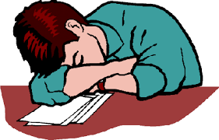
How Do You Know If You Have Test Anxiety?
Test anxiety has many symptoms which include loss of sleep or appetite, sweaty palms, food cravings, and an inability to concentrate to name a few. Below are examples; select the statements that you identify with most. If you select more than five symptoms you may experience test anxiety. Most people experience these symptoms and they are not harmful; however, if you experience ten or more you may be suffering from severe test anxiety.
__ I do not sleep well the night before a test. __ I am always afraid that I will run out of time. __ I get sick if I eat anything before a test. __ I check the time constantly; noises bother me. __ I am irritable and hard to be around before a test. __ I get easily frustrated during the test. __ I see the test as a measure of my worth as a student. __ I have a negative attitude about testing. __ I blank out during the test and can't recall information. __ I think about not taking the test. __ I worry when others are still testing and I am finished. __ I always average my grades before the test. __ I worry when others finish and I am still testing. __ My body sweats, heart pounds; feel nauseous.

Slide 7

How Does Test Anxiety Affect You?
Anxiety may cause you to have a physiological, behavioral, or even a psychological effect.
Physiological – rapid heartbeat, knot in stomach, headache, tension, profuse perspiration.
Behavioral – indecisive about an answer, “going blank”, inability to organize your thoughts.
Psychological – feelings of nervousness, restlessness, or continual doubt.

Slide 8

What To Do Before The Test
Give yourself enough time to review the material – start at least a week early.
Ask your professor what the format of the test will be: multiple choice, essay, fill in the blank, true or false, etc.
Ask your professor questions such as: How long will the test be (amount of questions)? Is there a time limit? Will there be a study guide? Will there be a review session?
Make a list of the topic/chapters/materials that will be on the exam. Write down any formulas, definitions or key facts that you need to know. Look for these in your lecture notes, textbooks, sample tests, quizzes, and handouts.
If it helps you, make flash cards, outlines, drawings, etc. that will help you learn and remember the material. Visual aids such as these can help during the test.
Pay attention to the areas your professor spends a lot of time on in class. If your professor spent two weeks emphasizing a subject, then assume it will be on the exam. Ask your professor if out of class reading material will be included on the test.
DO NOT PROCRASTINATE. Don't worry about the amount of material you need to know: that's wasting time. Instead, start studying! Give each topic enough review time and spend the most time on subjects emphasized by the professor.

Slide 9
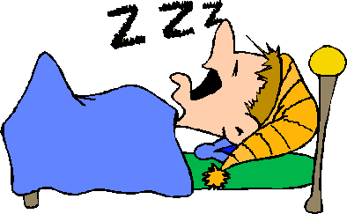
What To Do Before The Test (continued)
Test yourself on the material. As you write problems on the board, talk out loud about what you are doing. (Give the lecture!) If you can talk and write about it, you know it.
The night before the exam, gather any materials that you might need: pencil, pen, calculator, scantron, etc. Then, get a good night's sleep.
Avoid cramming. Cramming requires a great deal of energy, contributes to stress and tension, and does not last. Cramming is one of the reasons you may “blank out.”
Eat a healthy breakfast. Some foods that are recommended to reduce stress include fresh fruits and vegetables. In general, high carbohydrate foods won't sustain you while proteins will. Figure out what's best for you to eat in the mornings.
Be on time. Start out early, get a good parking spot, walk relaxed; slow things down.
Don't talk to other students before the exam because you might just get confused. Other students may be suffering from test anxiety and they can make you feel anxious if they start asking you questions. Remember: it's a solo experience.

Slide 10
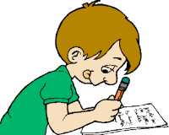
What To Do During The Test
READ THE DIRECTIONS CAREFULLY. Directions include vital information such as where to write your answers, how to write your answers, whether spelling counts, if you need to show all your work, etc. You may lose vital points because you didn't follow directions.
Pace yourself and budget your time. Avoid looking at the clock – just focus on the test.
If you blank on a question, skip it and move on. Sometimes reading other test questions will help you remember answers to those questions you skipped.
If others are turning in their tests, don't panic. There's no prize for finishing first. Stay focused.
Remember to relax, breathe, and don't think about fear or the consequences of the exam. Just put your best foot forward and do your personal best.

Slide 11

What To Do After The Test
FORGET ABOUT IT. Yes! It's all over. Go home and relax.
Don't talk to others about what was on the exam. Asking questions such as “What did you get for #25?” will not help you or the other person. Many professors give different versions of the exam (i.e., Version A, B, C) so you might not be asking about the same question. Worrying about an answer after the test is over contributes to test anxiety.
Treat yourself. If you have no other commitments (i.e., other exams or class), spend some time relaxing and doing a whole lot of nothing.
After a couple of hours, try to list some factors that you think improved your test taking and reduced your test anxiety. Even if you list only a few, it's still a starting point that will lead to success of overcoming your test anxiety.

Slide 12
What Can You Do About Text Anxiety?
The mind is a powerful tool that may work either for you or against you.
Test anxiety can be controlled with an attitude adjustment.
Visualizing success can take you a long way.
If you tell yourself you can't succeed, then you won't.
If you tell yourself you can succeed and do well, you will.
Start by preparing before, during, and after an exam.

Slide 13

Tips for Managing Test Anxiety
Be prepared. Develop good study habits. Study at least a week or two before the exam, in smaller increments of time and over a few days (instead of pulling an "all-nighter"). Try to simulate exam conditions by working through a practice test, following the same time constraints.
Develop good test-taking skills. Read the directions carefully, answer questions you know first and then return to the more difficult ones. Outline essays before you begin to write.
Maintain a positive attitude. Remember that your self-worth should not be dependent on or defined by a test grade. Creating a system of rewards and reasonable expectations for studying can help to produce effective studying habits. There is no benefit to negative thinking.

Slide 14
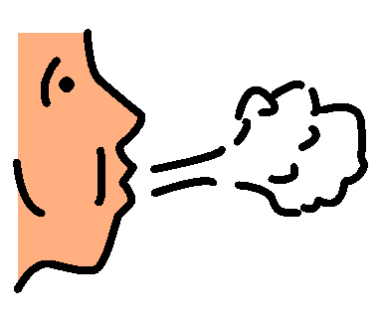
Tips for Managing Test Anxiety (continued)
Stay focused. Concentrate on the test, not other students during your exams. Try not to talk to other students about the subject material before taking an exam.
Practice relaxation techniques. If you feel stressed during the exam, take deep, slow breaths and consciously relax your muscles, one at a time. This can invigorate your body and will allow you to better focus on the exam.
Stay healthy. Get enough sleep, eat healthfully, exercise and allow for personal time. If you are exhausted—physically or emotionally—it will be more difficult for you to handle stress and anxiety.
Visit the counseling center. Schools are aware of the toll exams can take on students. They have offices or programs specifically dedicated to helping you and providing additional educational support so that you can be successful.

Slide 15
References
Bad Grades Clipart. (2017). Clipart Fest. Retrieved March 17, 2017, from https://img.clipartfest.com/1872b43ed3e0d427943f2011e3d7d8ce_bad-grade-clipart-1-bad-grades-clipart_1567-917.jpeg
Child Sleeping. (2017). Clipart Panda. Retrieved March 17, 2017, from http://images.clipartpanda.com/supervision-clipart-sleep.gif
College Student Studying. (2017). Clip Art Panda. Retrieved March 17, 2017, from http://images.clipartpanda.com/college-student-studying-clipart-good-student-clipart-196.jpg
Following Directions Clipart. (2017). Clipart Fest. Retrieved March 17, 2017, from https://img.clipartfest.com/0af660eb7ad86c37e80f52d4a739e111_-not-following-directions-clipart-following-directions_200-160.gif
How to Study Clipart. (2017). Milwaukee Area Technical College. Retrieved March 17, 2017, from http://s3.amazonaws.com/libapps/accounts/20860/images/student-writing-clipart-free-clipart-images.jpg
Nervous Face Clipart. (2017). A Perfect World. Retrieved March 17, 2017, from http://www.aperfectworld.org/clipart/emotions/nervous02.png
Overcoming Test Anxiety. (2017). Study Guides and Strategies. Retrieved March 17, 2017, from http://www.studygs.net/tstprp8.htm
Person Taking a Deep Breath Clipart. (2017). URMC Rochester. Retrieved March 17, 2017, from https://www.urmc.rochester.edu/MediaLibraries/URMCMedia/childrens-hospital/developmental-disabilities/ndbp-site/images/pcs-symbols/deep-breaths.jpg
Poor Night’s Sleep Clipart. (2016). MHS Blueprints. Retrieved March 17, 2017, from https://www.mhsblueprints.com/wp-content/uploads/2016/02/Sleep-Deprivation.gif
Relaxing on the Beach. (2017). Clipart Kid. Retrieved March 17, 2017, from http://www.clipartkid.com/images/497/hawaii-beach-clipart-cliparthut-free-clipart-Na6zKT-clipart.jpg
Student Taking a Test Clipart. (2017). Study Pedia. Retrieved March 17, 2017, from https://studypedia.com/wp-content/uploads/2016/02/student-taking-a-test-clipart-children-exam.gif
Text Anxiety. (2017). Anxiety and Depression Association of America. Retrieved March 17, 2017, from https://www.adaa.org/living-with-anxiety/children/test-anxiety
Test Anxiety. (2017). California Polytechnic State University. Retrieved March 17, 2017, from http://sas.calpoly.edu/asc/ssl/testanxiety.html
Test Anxiety. (2017). Kids Health. Retrieved March 17, 2017, from http://kidshealth.org/en/teens/test-anxiety.html
Test Anxiety Clipart. (2017). MHS Counseling Corner. Retrieved March 17, 2017, from https://activerain-store.s3.amazonaws.com/image_store/uploads/agents/askmary/files/Test%20angst.jpg

Slide 16
Activities
Overcoming Test Anxiety Worksheet
Overcoming Test Anxiety Quiz
Overcoming Test Anxiety Flyer
Create a flyer with the following information:
What is Anxiety?
Causes of Anxiety
Symptoms of Anxiety
Tips
Test Anxiety Inventory

